Slide 1
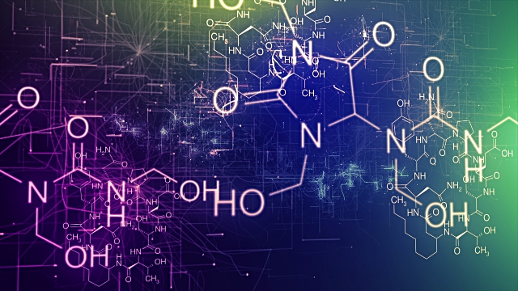
Lecture 2: Body Chemistry
0

Slide 2
OVERVIEW
Structure vs. Function – how does anatomy control physiology?
Body Organization: Organic Molecules – what molecules make up the human body
Diffusion and Osmosis – how and why do molecules move?
Body Organization: The Cell – how does the plasma membrane function?
Notes:
Answer: c

Slide 3
HOMEOSTASIS
Must be maintained in order to survive
Homeostasis is what makes organisms different from their environment
Disease occurs when homeostatic responses fail
Accomplished by organ systems functioning together

Slide 4
ORGANIC MOLECULES
Water
Carbohydrates
Proteins
Lipids
Nucleic acids
Adenosine Triphosphate (ATP)
Electrolytes

Slide 5
ORGANIC MOLECULES: WATER
A solution is a liquid that is a homogeneous mixture of substances
A solvent is the dissolving agent of a solution
The solute is the substance that is dissolved
Notes:
5

Slide 6
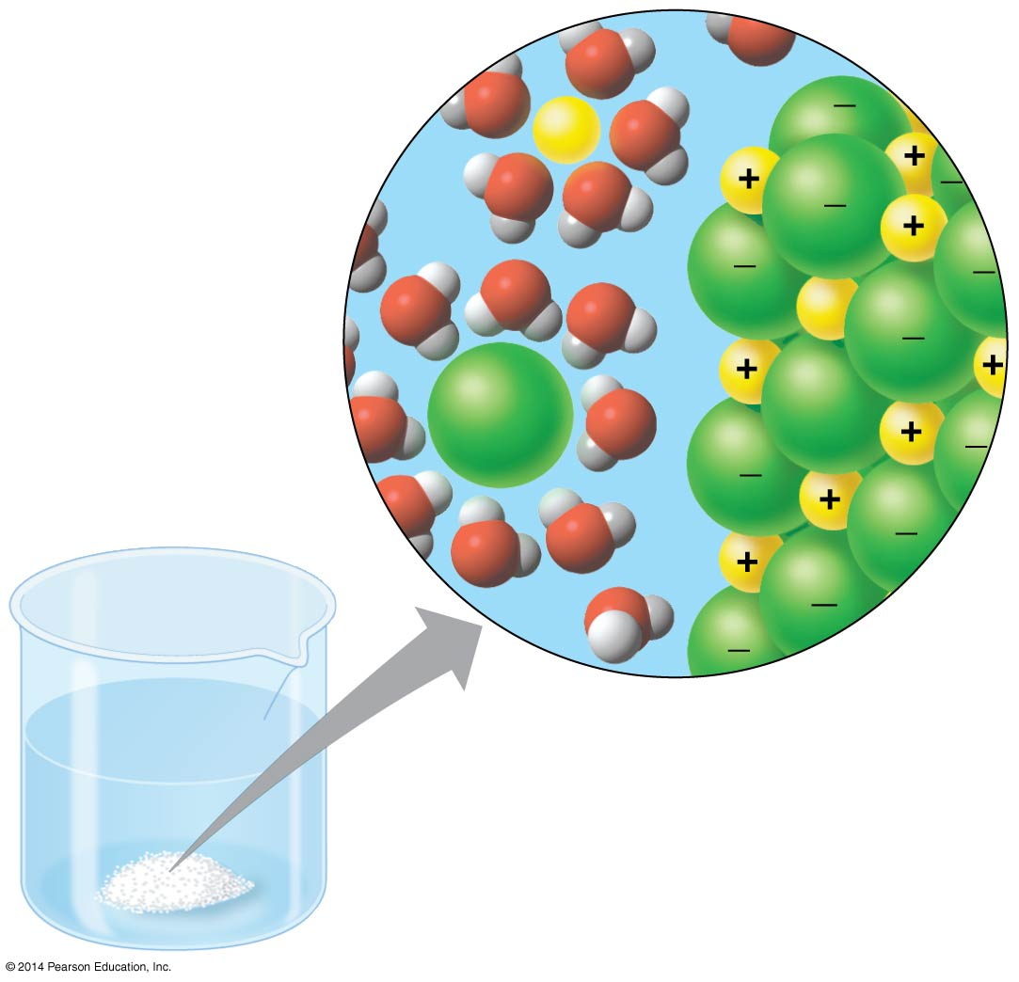
ORGANIC MOLECULES: WATER
Water is a versatile solvent due to its charge, which allows it to attract other charged molecules
Notes:
6

Slide 7
ORGANIC MOLECULES: WATER
A hydrophilic substance is one that has an affinity for water
These are typically charged substances because the charges are attracted to a water molecule’s charge
A hydrophobic substance is one that does not have an affinity for water
These are typically uncharged substances because they repelled by a water molecule’s charge
Example) Oil molecules are hydrophobic because they have uncharged bonds
Notes:
7

Slide 8
ORGANIC MOLECULES: CARBOHYDRATES
Carbohydrates are organic molecules involved with energy, metabolism, and structural support
Contain oxygen

Slide 9
ORGANIC MOLECULES: CARBOHYDRATES
Composed of units of glucose
4 Types of Carbohydrates:
Sugars = Energy use, conversion to ATP
Glycogen = Energy storage in animals
Starch = Energy storage in plants
Cellulose = Structural components of cell walls in plants

Slide 10
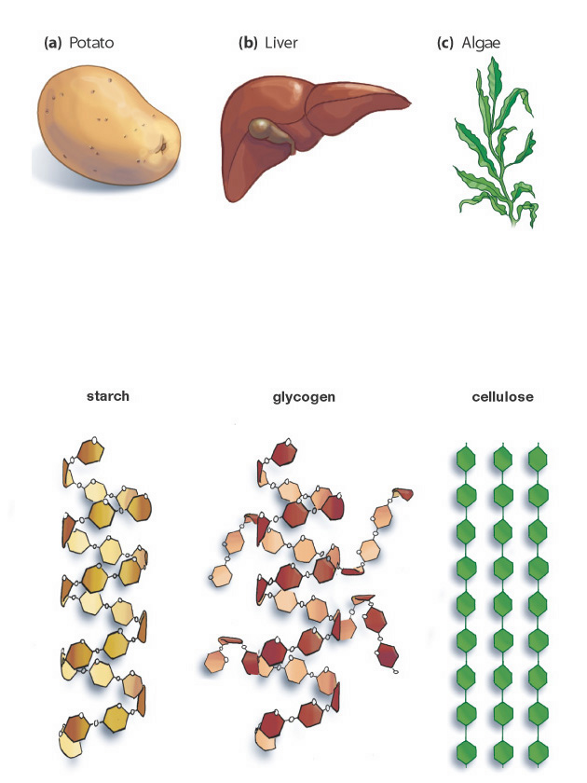
ORGANIC MOLECULES: CARBOHYDRATES

Slide 11
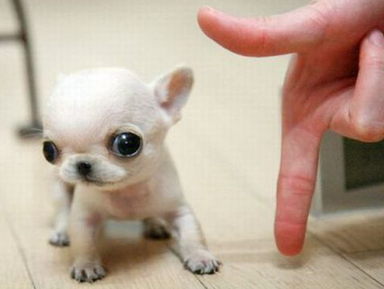
WHY DOES THIS MATTER?
Puppies are prone to hypoglycemia, or low blood sugar
Minimal muscle tissue
Immature liver
The result is life-threatening
This is one reason why we wean puppies when we do
Notes:
11

Slide 12
ORGANIC MOLECULES: LIPIDS
Lipids are organic molecules involved with energy, cellular protection, and hormonal regulation
Unified by hydrophobia
3 Types of Lipids:
Triglycerides: Found in the diet
Phospholipids: Found in cell membranes
Steroids: Found in cell membranes and hormones

Slide 13
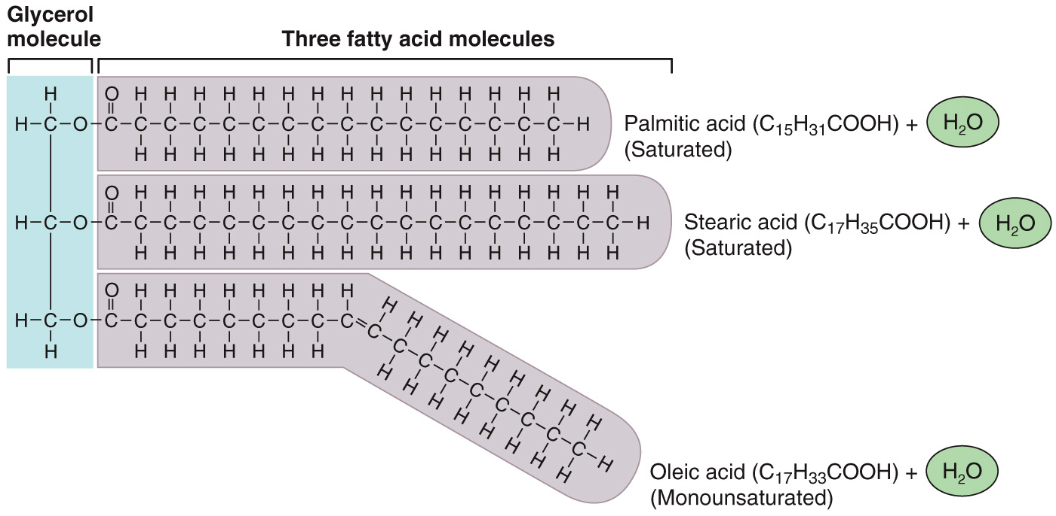
ORGANIC MOLECULES: LIPIDS

Slide 14
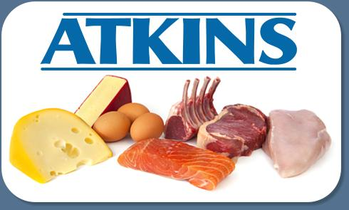
WHY DOES THIS MATTER?
So if triglycerides are so efficient, why do we store carbohydrates at all?
It is easy for the body to use carbs, so they provide a more immediate energy source.
This is the theory behind the Atkins and Keto Diets.
Notes:
14

Slide 15
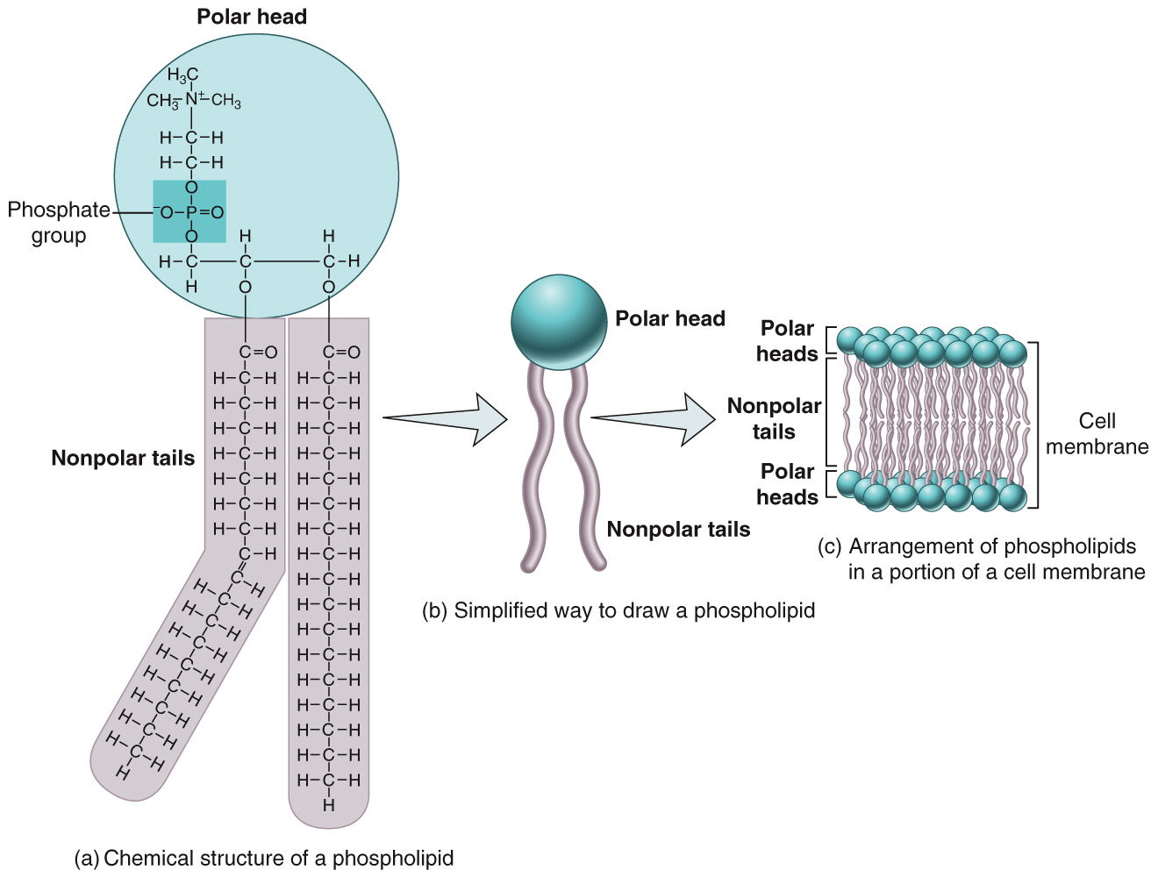
ORGANIC MOLECULES: LIPIDS
Phospholipids
Hydrophilic head
Hydrophobic tails

Slide 16
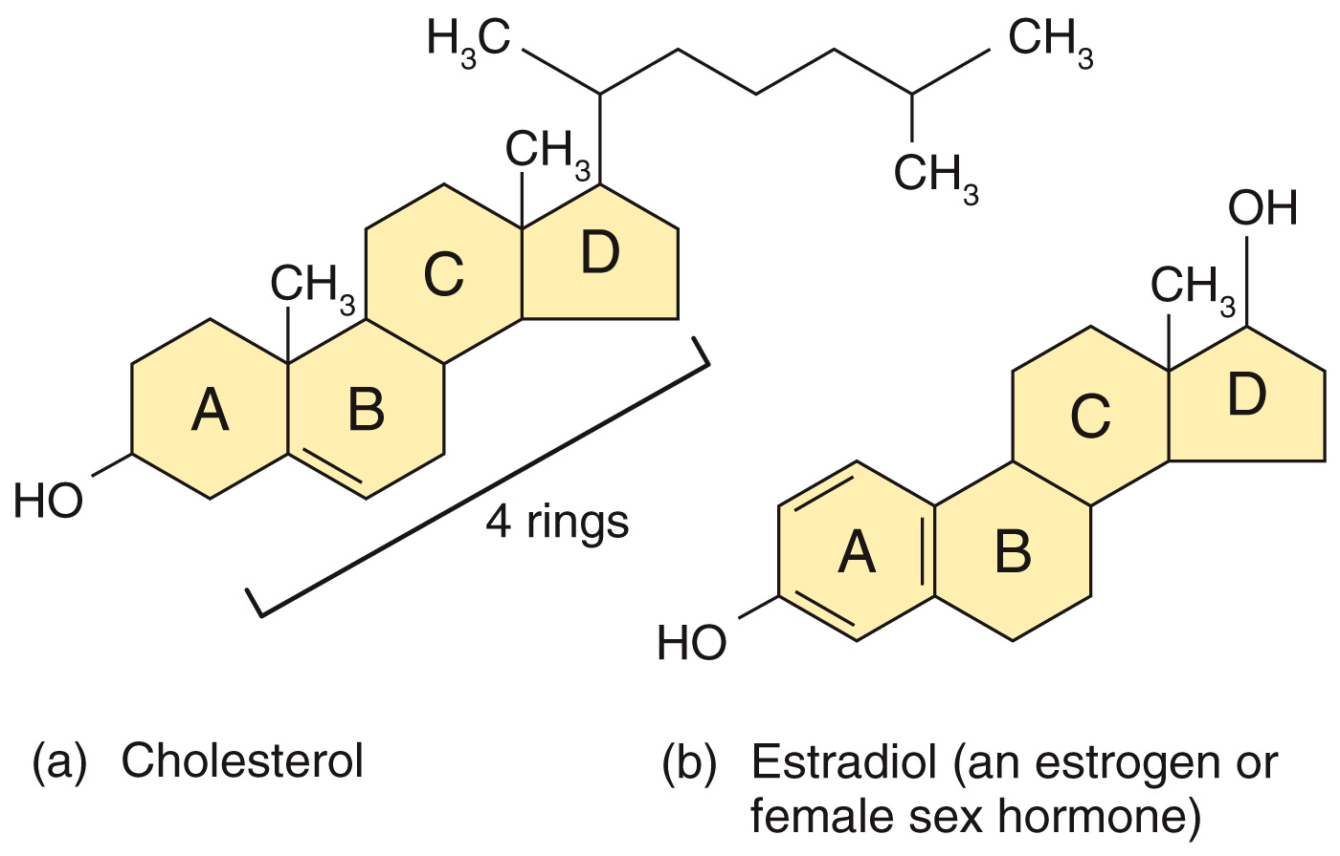
ORGANIC MOLECULES: LIPIDS
Steroids
4 Rings

Slide 17
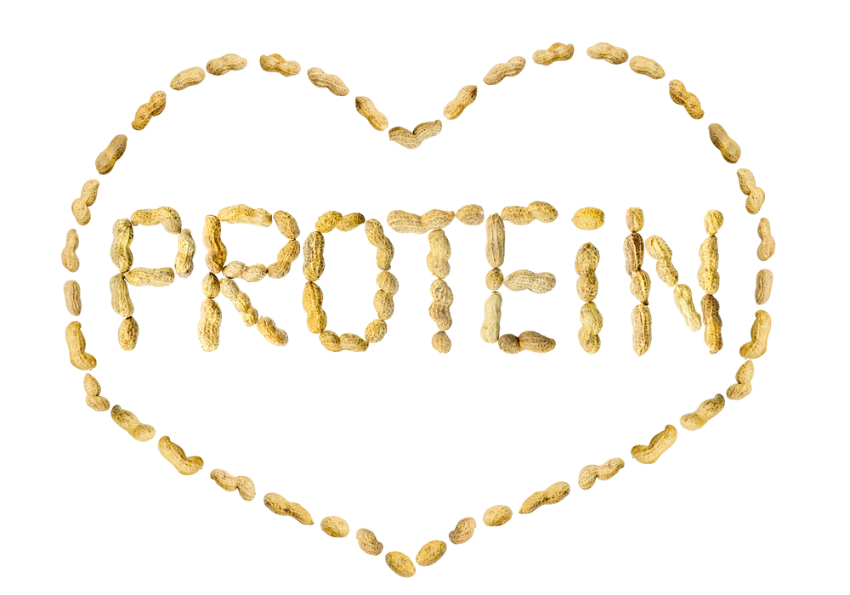
ORGANIC MOLECULES: PROTEINS
Proteins are responsible for almost everything about a life form
A cell’s “job” is to make certain types of proteins
Pancreatic cells = Insulin (a protein)
Hair follicle cells = Keratin (a protein)
Skin cells = Melanin (a protein)
Even DNA are simply instructions on what proteins to make

Slide 18
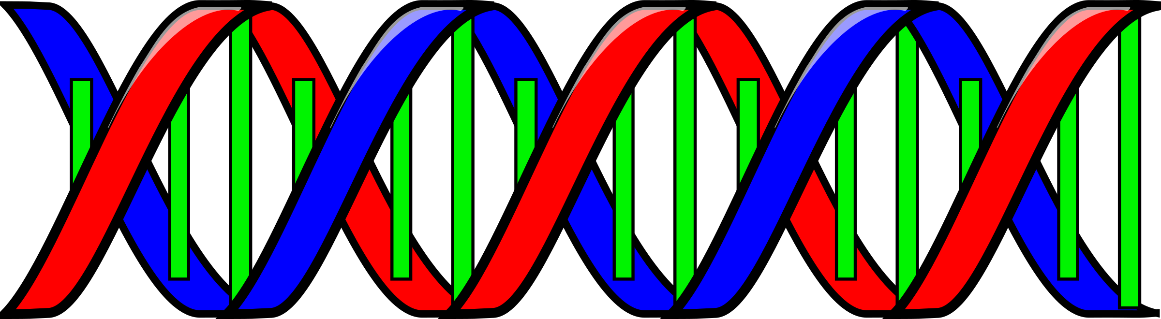
ORGANIC MOLECULES: NUCLEIC ACIDS
DNA = Provides the blueprint of life
Inherited from parents
Instructions on how to make proteins
RNA = Carries information in DNA throughout the cell
Link between DNA and protein

Slide 19
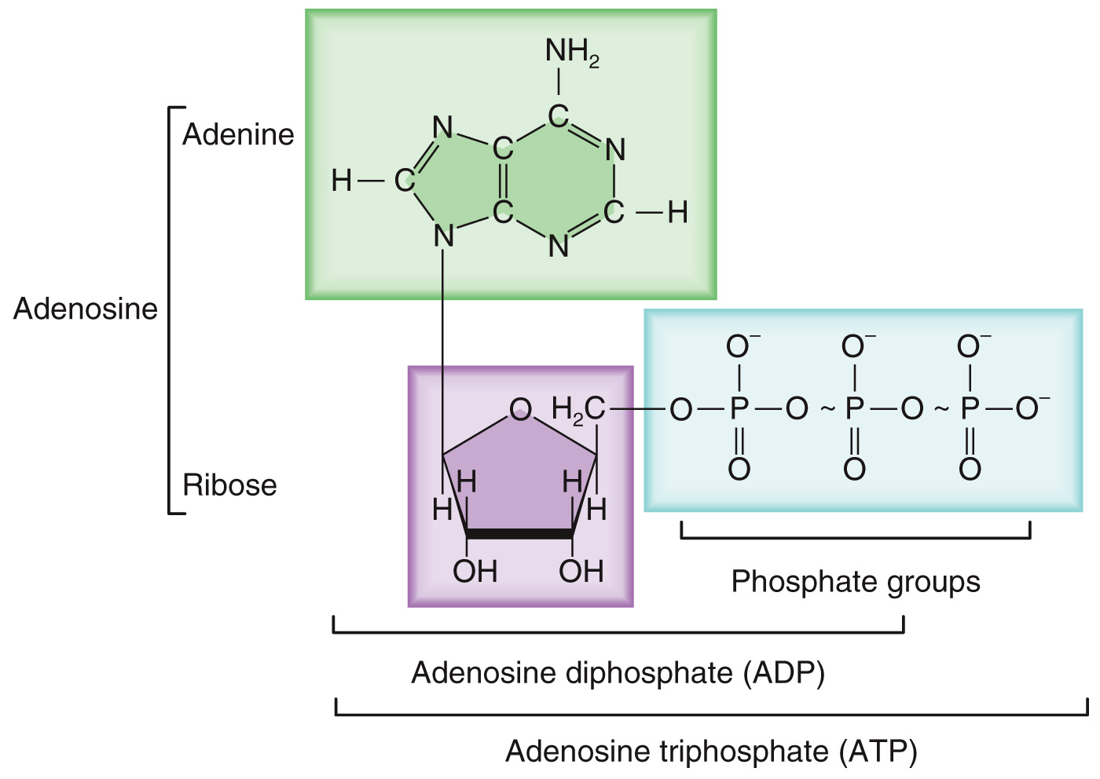
ORGANIC MOLECULES: ATP
Adenosine triphosphate (ATP)
Chemical energy used by all cells

Slide 20
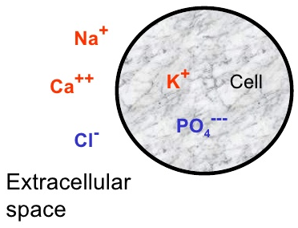
ORGANIC MOLECULES: ELECTROLYTES
Charged atoms
Obtained from diet
Inside and outside the cell at different ratios
The cell uses energy to keep some electrolytes OUT and other electrolytes IN
Drive cell function
Control osmosis

Slide 21
DIFFUSION
Molecules are in constant motion.
This movement is random.
Diffusion = Because molecules are in constant motion, they tend to move so their concentration is equal throughout a solution.
A substance will diffuse from where it is more concentrated to less concentrated.
It will travel DOWN its concentration gradient

Slide 22
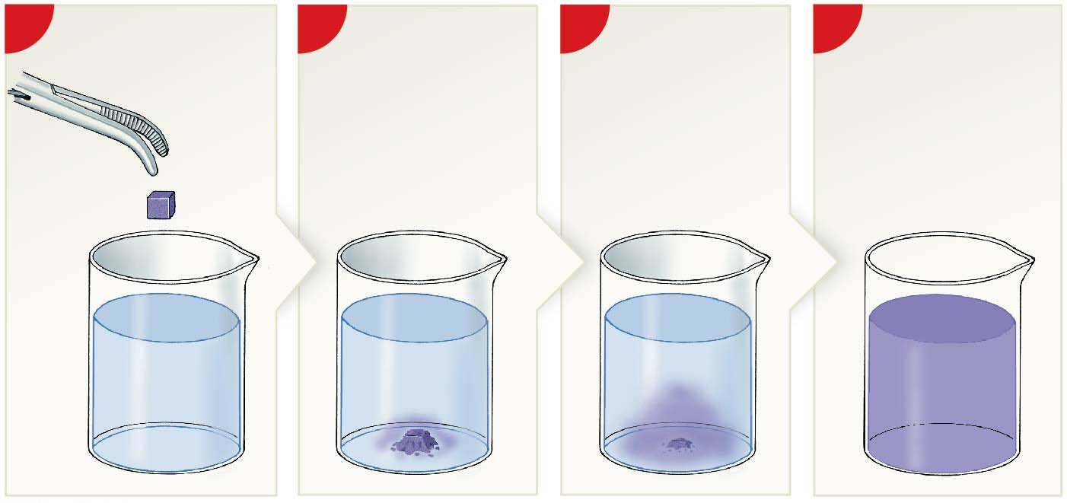
DIFFUSION
1
Placing a colored sugar
cube into a water-filled
2
As the cube begins to
dissolve, many sugar
and dye molecules are
in one location, and
none are elsewhere.
3
With time, the
sugar and dye
molecules spread
through the water.
4
Eventually, the concen-
tration gradient is
eliminated and the
molecules are evenly
distributed throughout
the solution.
beaker establishes a
steep concentration
gradient.

Slide 23
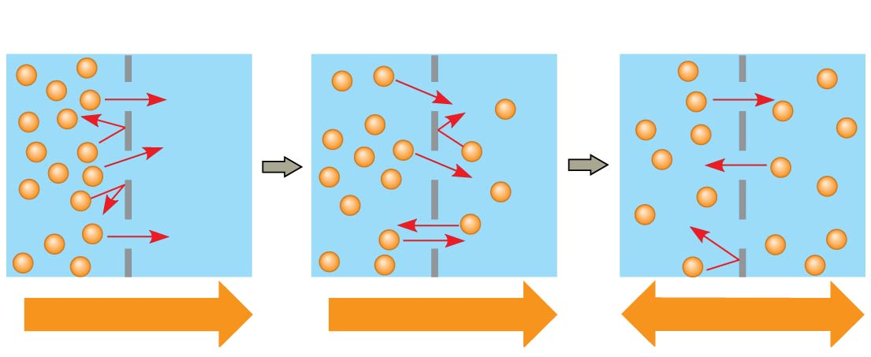
DIFFUSION
Molecules of Na⁺ (sodium)
Membrane
WATER
Net diffusion
Net diffusion
Equilibrium

Slide 24
DIFFUSION
Substances move from:
HIGH concentrations
to
LOW concentrations
This is called moving DOWN the concentration gradient

Slide 25
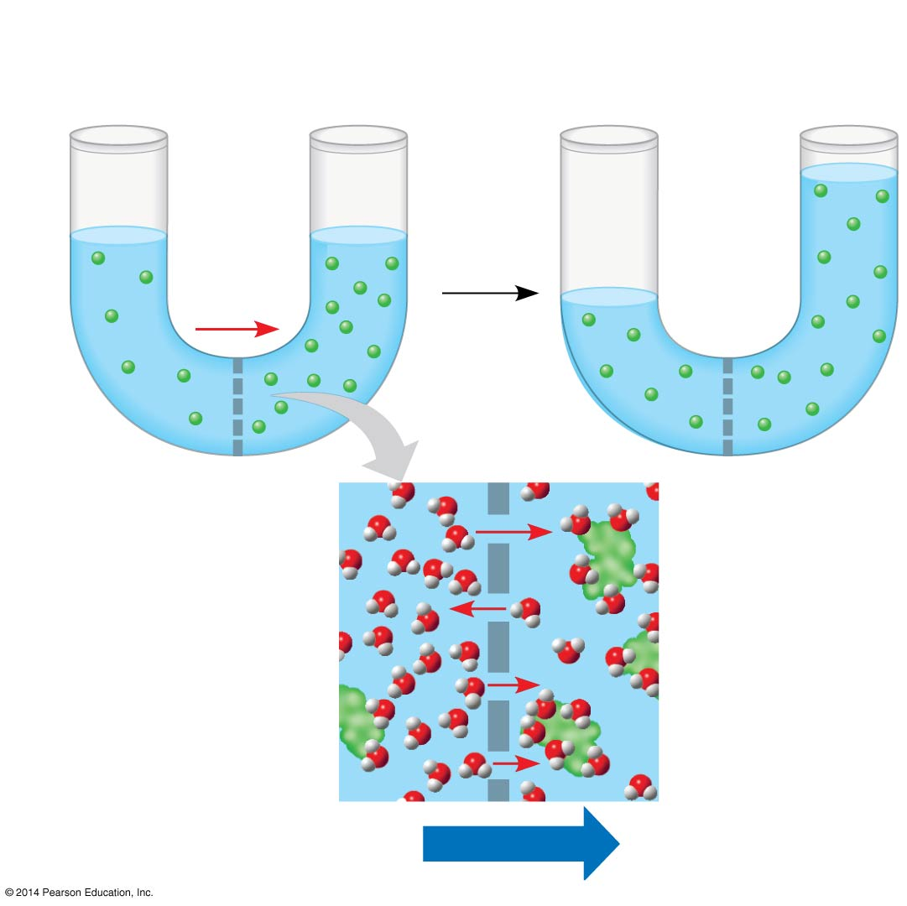
OSMOSIS
Osmosis = DIFFUSION of water across a membrane.
H₂O

Slide 26
OSMOSIS

Slide 27
OSMOSIS
Water moves from:
Low SOLUTE concentrations
to
High SOLUTE concentrations
This is still moving DOWN its own concentration gradient

Slide 28
Where you expect water molecules to move?

Slide 29
OSMOSIS
Isotonic environment: Concentration is the same as inside the cell; no net water movement across the plasma membrane
Hypotonic environment: Concentration is LOWER in the environment than that inside the cell.
Hypertonic environment: Concentration is GREATER in the environment than inside the cell

Slide 30
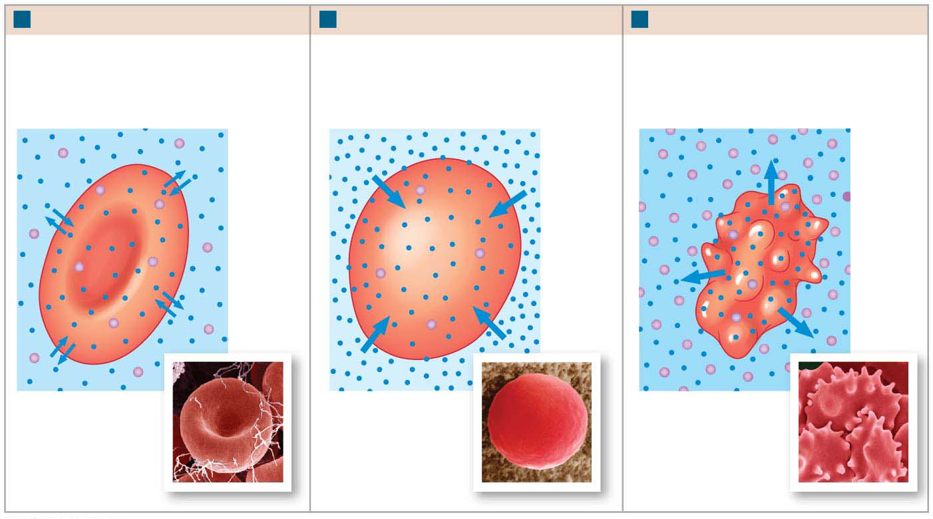
OSMOSIS
a
Isotonic solution
b
Hypotonic solution
c
Hypertonic solution
In an isotonic saline solution, no
osmotic flow occurs, and the shape
of the red blood cell (RBC) appears
normal.
In a hypotonic solution, the water
flows into the red blood cell. The
swelling may continue until the
plasma membrane ruptures, or lyses.
In a hypertonic solution, water
moves out of the red blood cell.
The cell shrivels and becomes
crenated.
Water
molecules
Solute
molecules
SEM of a normal RBC
in an isotonic solution
SEM of an RBC in a
hypotonic solution
SEM of crenated RBCs
in a hypertonic solution

Slide 31
Which image shows what happens to your cells if you drink salt water? Left, Middle, or Right

Slide 32
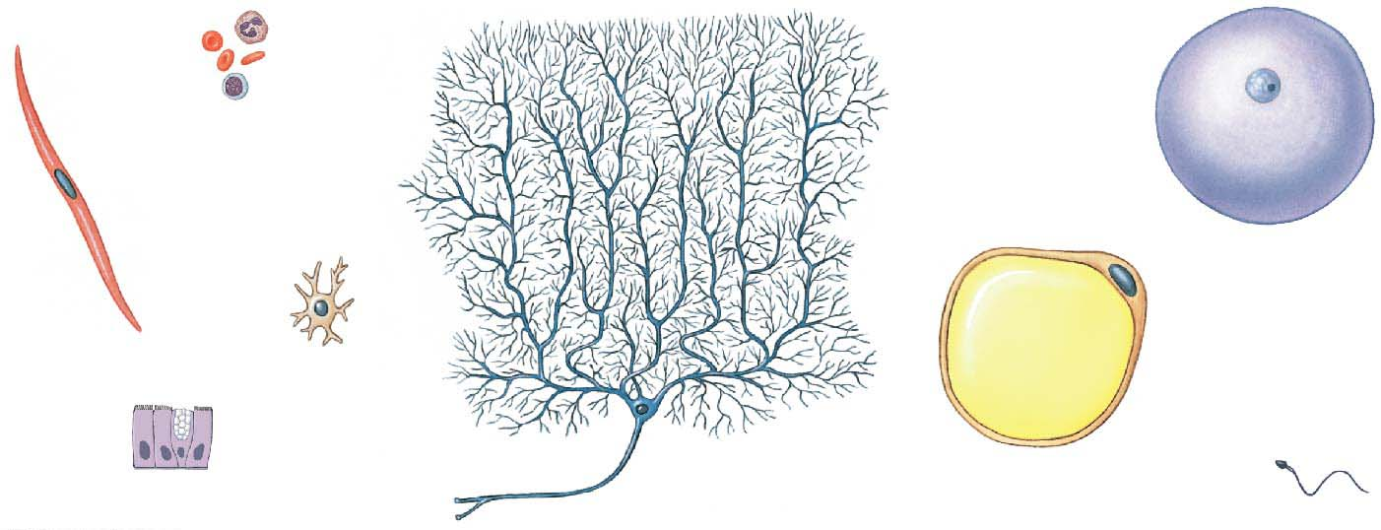
THE CELL
All living organisms are composed of cells.
Blood
cells
Ovum
Smooth
muscle cell
Bone
cell
Fat cell
Cells lining
intestinal tract
Neuron in brain
Sperm

Slide 33
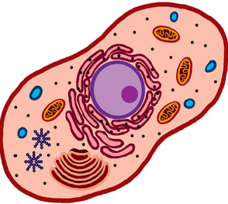
THE CELL
Plasma Membrane
Nucleus
Cytoplasm

Slide 34
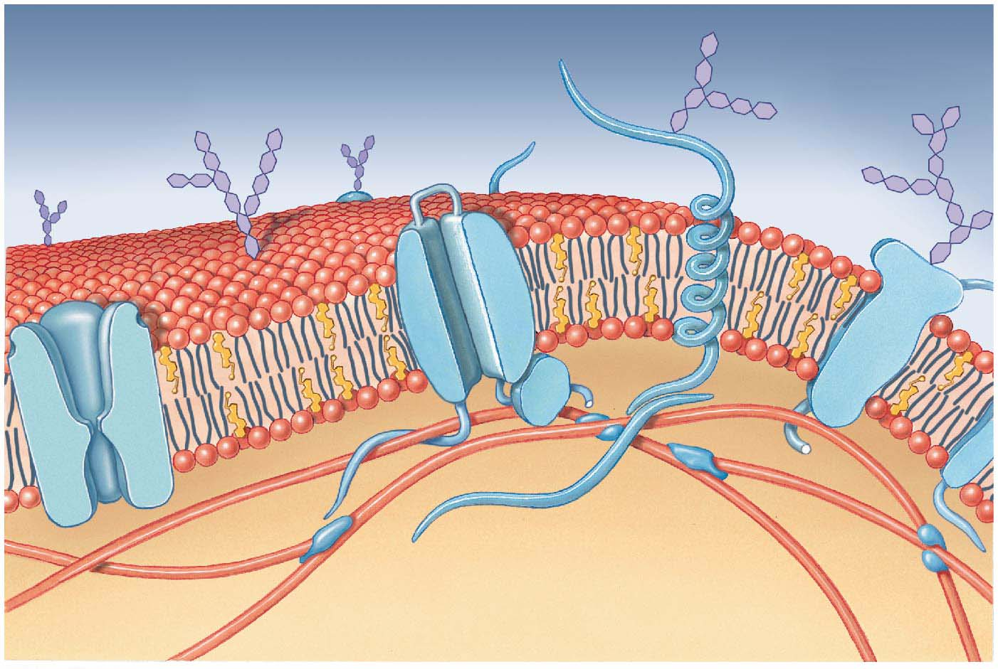
THE PLASMA MEMBRANE
Functions:
Protection
Regulates what enters and exits the cell
Phospholipid bilayer
Surrounds cells and organelles

Slide 35
THE PLASMA MEMBRANE
Hydrophobic molecules cross the membrane easily without help
They can dissolve in the lipid bilayer of the membrane
Hydrophilic molecules, such as sugars, do not cross the membrane easily and need help

Slide 36
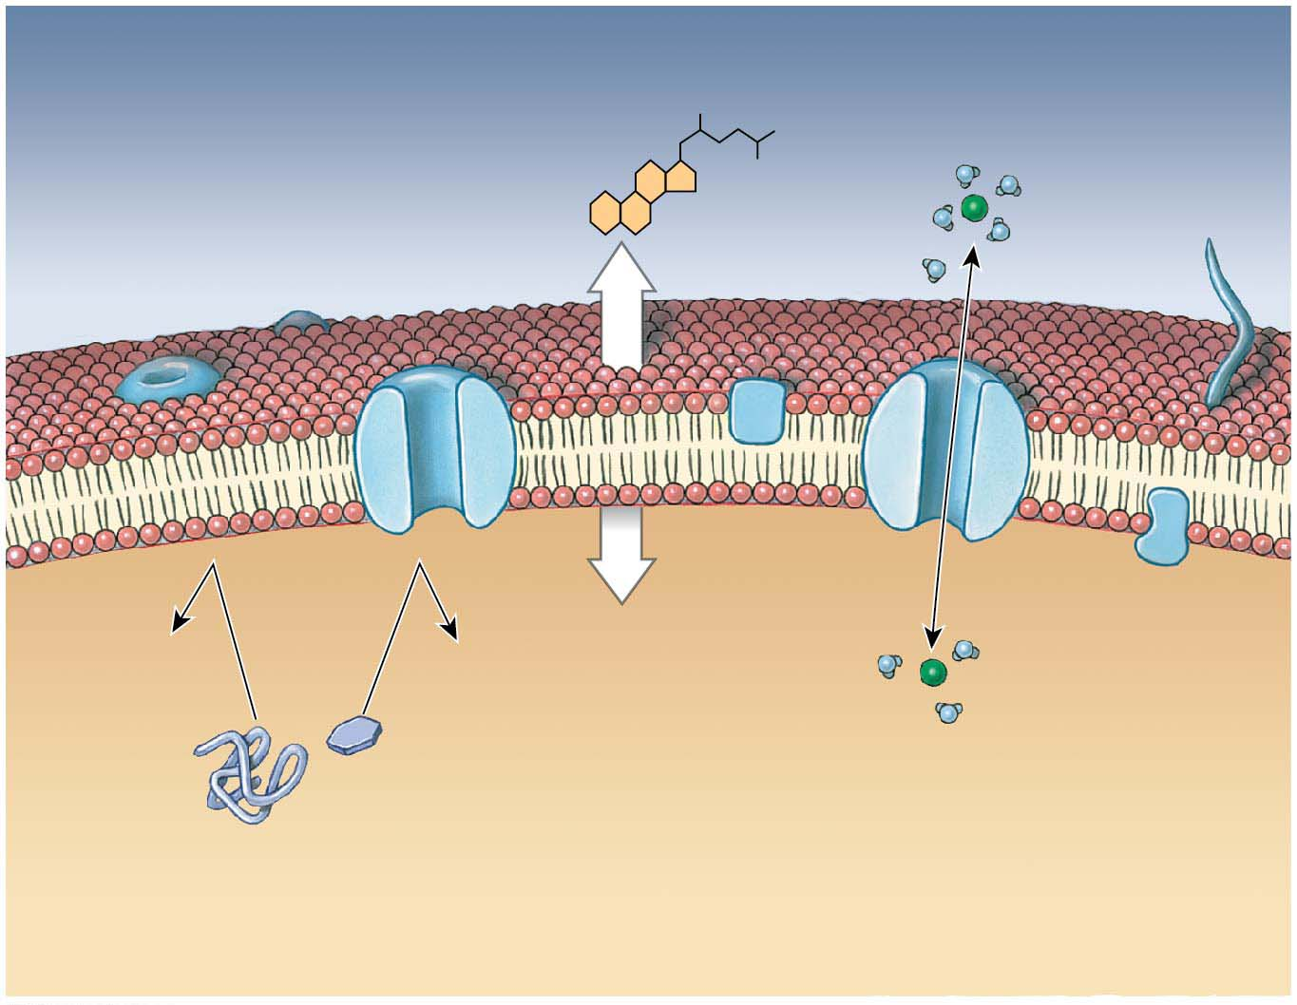
PLASMA MEMBRANE
EXTRACELLULAR FLUID
Hydrophobic molecules
diffuse through the
plasma membrane without help
PLASMA MEMBRANE
Transport
protein
Hydrophilic molecules and ions diffuse through channels created by transport proteins
Large molecules cannot
diffuse through lthe plasma membrane
without transport proteins
CYTOPLASM

Slide 37
THE PLASMA MEMBRANE
How do you know whether a solute moves OUT of the cell or INTO the cell?
Solutes move from:
HIGH concentrations
to
LOW concentrations

Slide 38
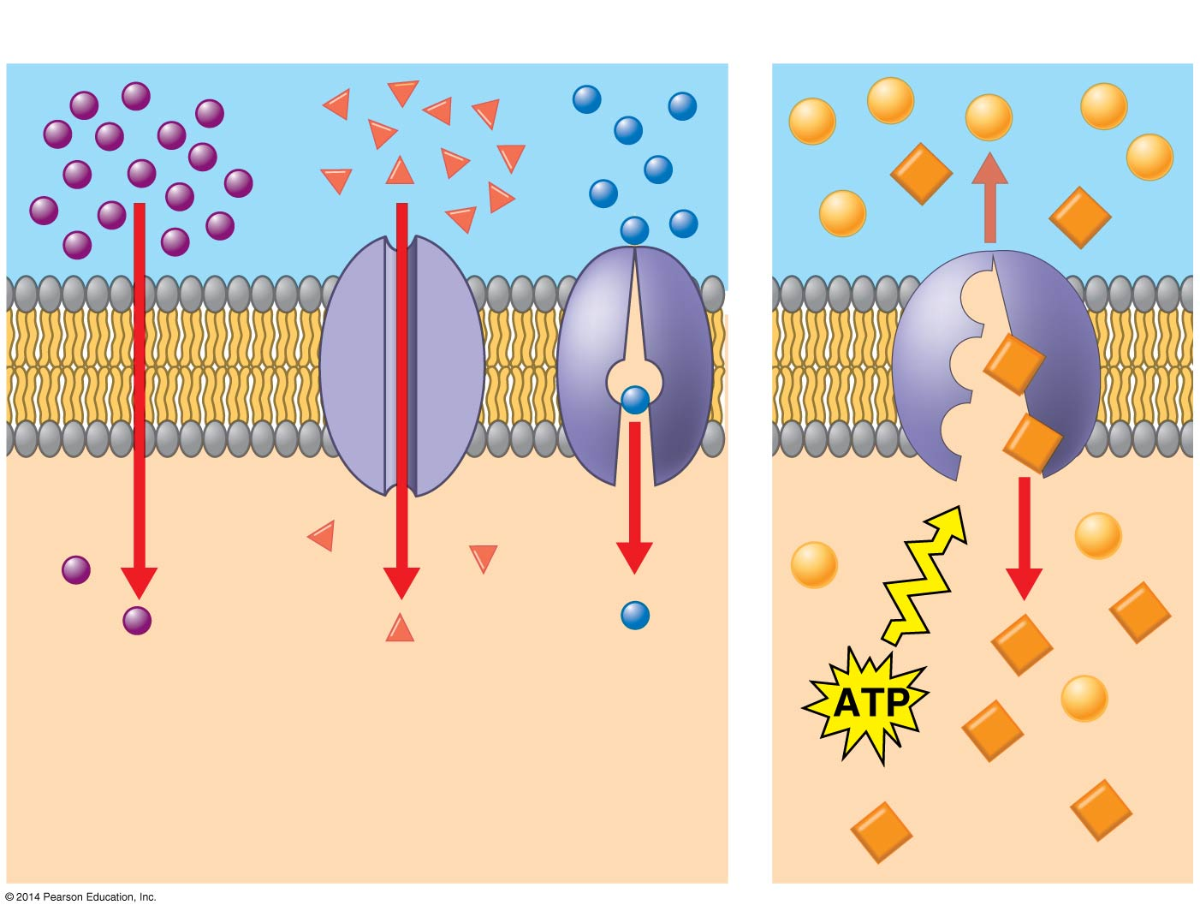
THE PLASMA MEMBRANE
Moving down the concentration gradient does NOT require energy!

Slide 39
THE PLASMA MEMBRANE
How do you know whether water moves OUT of the cell or INTO the cell?
Water moves from:
LOW solute concentrations
to
HIGH solute concentrations

Slide 40
THE PLASMA MEMBRANE
HIGH free water concentration
LOW sugar concentration
MOVEMENT OF WATER
LOW free water concentration
HIGH sugar concentration

Slide 41
THE PLASMA MEMBRANE
Active Transport: Moving AGAINST the concentration gradient DOES require energy!

Slide 42
THE PLASMA MEMBRANE
Active Transport moves molecules from:
LOW concentrations
to
HIGH concentrations

Slide 43
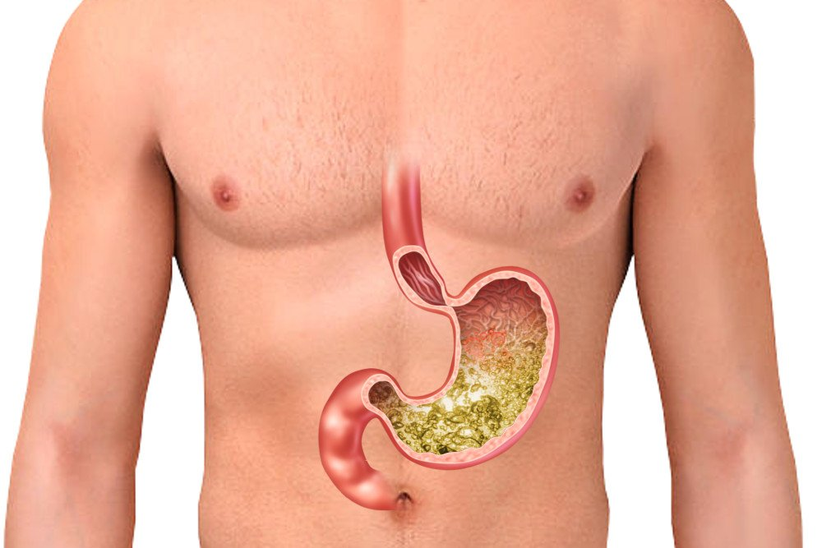
THE PLASMA MEMBRANE
H⁺
H⁺
H⁺

Slide 44
Which scenario requires energy?

Slide 45
THE PLASMA MEMBRANE
Some molecules are too big cross the membrane → use Bulk Transport instead
ENDOCYTOSIS means “into the cell”
There are three types of endocytosis
1) Phagocytosis (“cellular eating”)
2) Pinocytosis (“cellular drinking”)
3) Receptor-mediated endocytosis
Bulk transport requires energy (ATP)

Slide 46
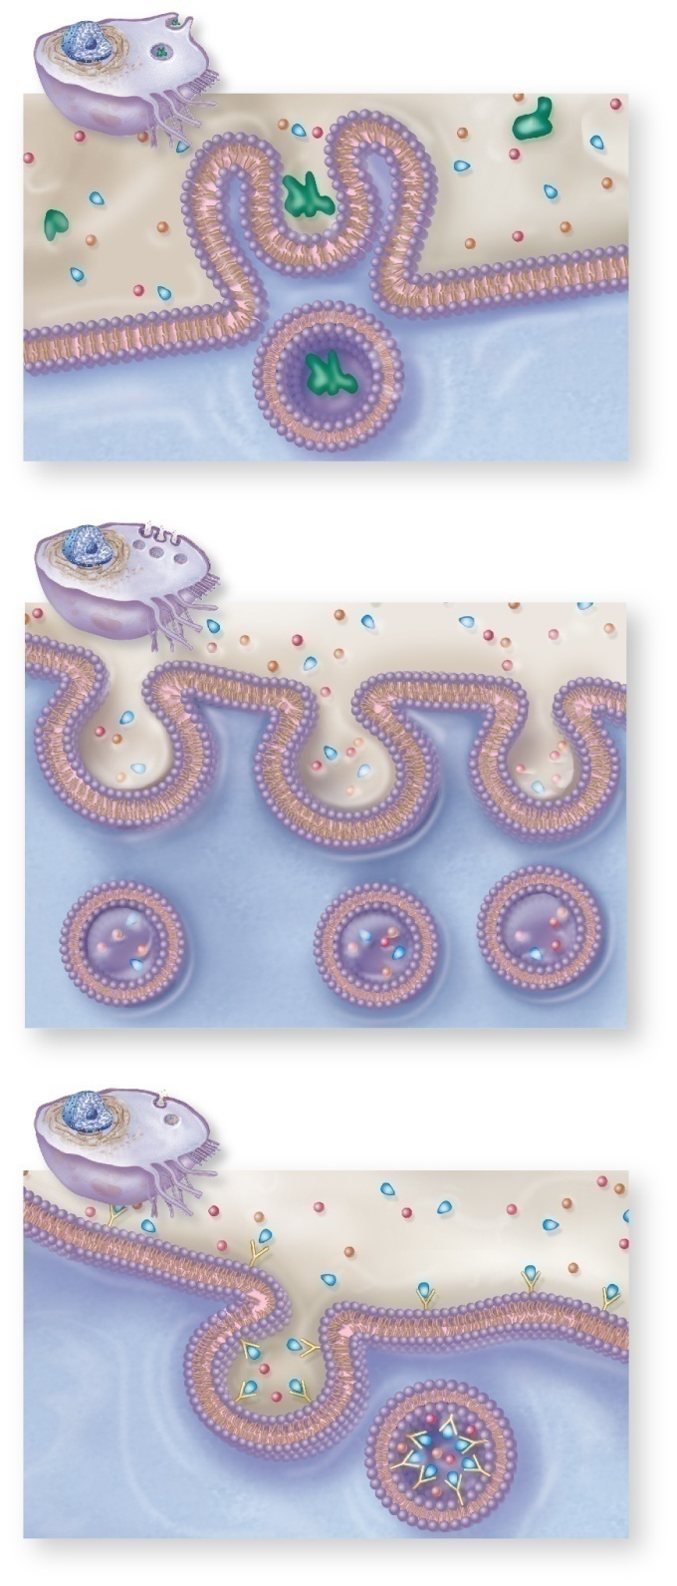
THE PLASMA MEMBRANE
Phagocytosis: Bulk transport of solid particles
Outside Cell
Inside Cell

Slide 47
THE PLASMA MEMBRANE
Pinocytosis: Bulk transport of nearby liquid
Outside Cell
Inside Cell

Slide 48
THE PLASMA MEMBRANE
Receptor-Mediated Endocytosis: Bulk transport of substances with low extracellular concentrations
1
Outside Cell
Inside Cell

Slide 49
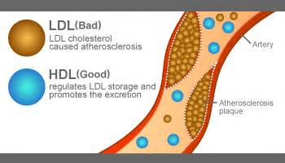
WHY DOES THIS MATTER?

Slide 50
PLASMA MEMBRANE SUMMARY
Function = Protection
The plasma membrane is like the skin
Transport
Hydrophobic molecules enter easily
Hydrophilic molecules need the help of proteins
Large molecules need bulk transport
Diffusion vs. Active Transport
Diffusion: NO ATP required
Active: ATP required

